Slide 1

CHAPTER 1
Introduction
Notes:
1.#

Slide 2
Objectives
After studying this chapter, the student should be able to:
Define the Turing model of a computer.
Define the von Neumann model of a computer.
Describe the three components of a computer: hardware,
data, and software.
List topics related to computer hardware.
List topics related to data.
List topics related to software.
Give a short history of computers.
Notes:
1.#

Slide 3
1-1 TURING MODEL
The idea of a universal computational device was first described by Alan Turing in 1937. He proposed that all computation could be performed by a special kind of a machine, now called a Turing machine. He based the model on the actions that people perform when involved in computation. He abstracted these actions into a model for a computational machine that has really changed the world.
Notes:
1.#

Slide 4
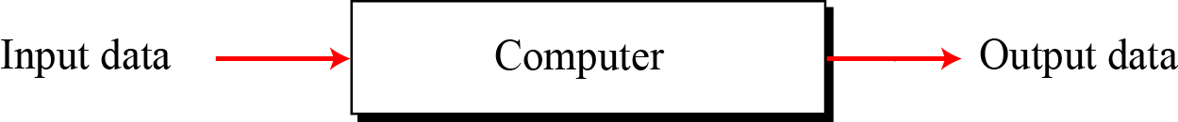
1.1.1 Data processors
Before discussing the Turing model, let us define a computer as a data processor. Using this definition, a computer acts as a black box that accepts input data, processes the data, and creates output data (Figure 1.1). Although this model can define the functionality of a computer today, it is too general. In this model, a pocket calculator is also a computer (which it is, in a literal sense).
Figure 1.1 A single purpose computing machine
Notes:
1.#

Slide 5
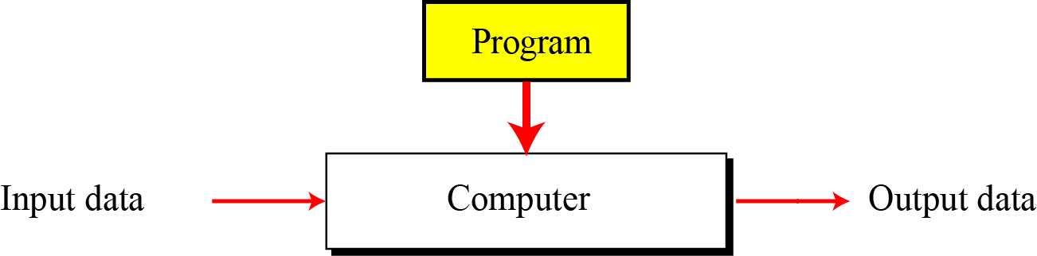
1.1.2 Programmable data processors
The Turing model is a better model for a general-purpose computer. This model adds an extra element to the specific computing machine: the program. A program is a set of instructions that tells the computer what to do with data. Figure 1.2 shows the Turing model.
Figure 1.2 A computer based on the Turing model
Notes:
1.#

Slide 6
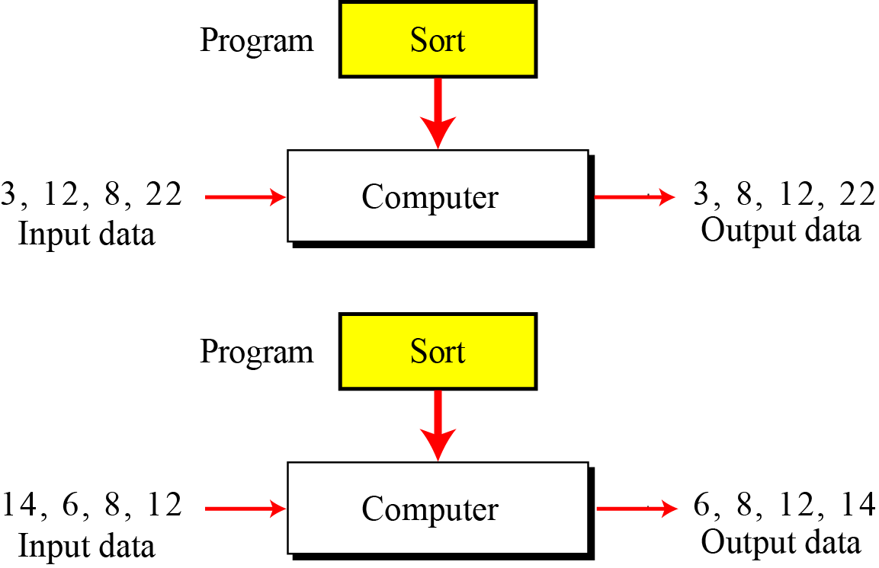
Figure 1.3 The same program, different data
Notes:
1.#

Slide 7
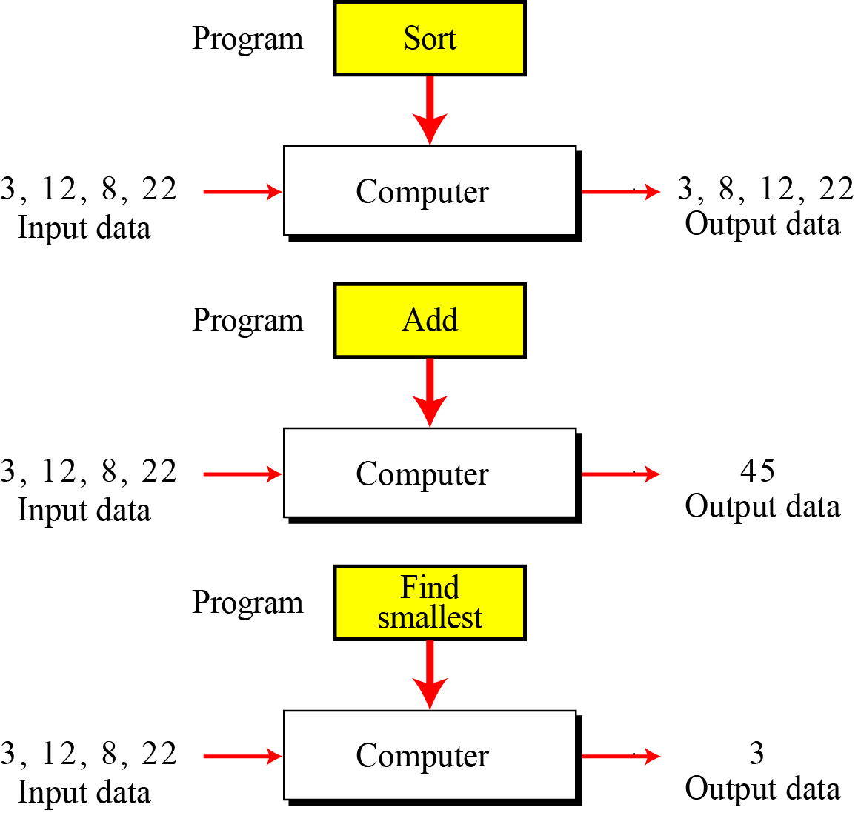
Figure 1.4 The same data, different programs
Notes:
1.#

Slide 8
1.1.3 The universal Turing machine
A universal Turing machine, a machine that can do any computation if the appropriate program is provided, was the first description of a modern computer. It can be proved that a very powerful computer and a universal Turing machine can compute the same thing. We need only provide the data and the program—the description of how to do the computation—to either machine. In fact, a universal Turing machine is capable of computing anything that is computable.
Notes:
1.#

Slide 9
1-2 VON NEUMANN MODEL
Computers built on the Turing universal machine store data in their memory. Around 1944–1945, John von Neumann proposed that, since program and data are logically the same, programs should also be stored in the memory of a computer.
Notes:
1.#

Slide 10
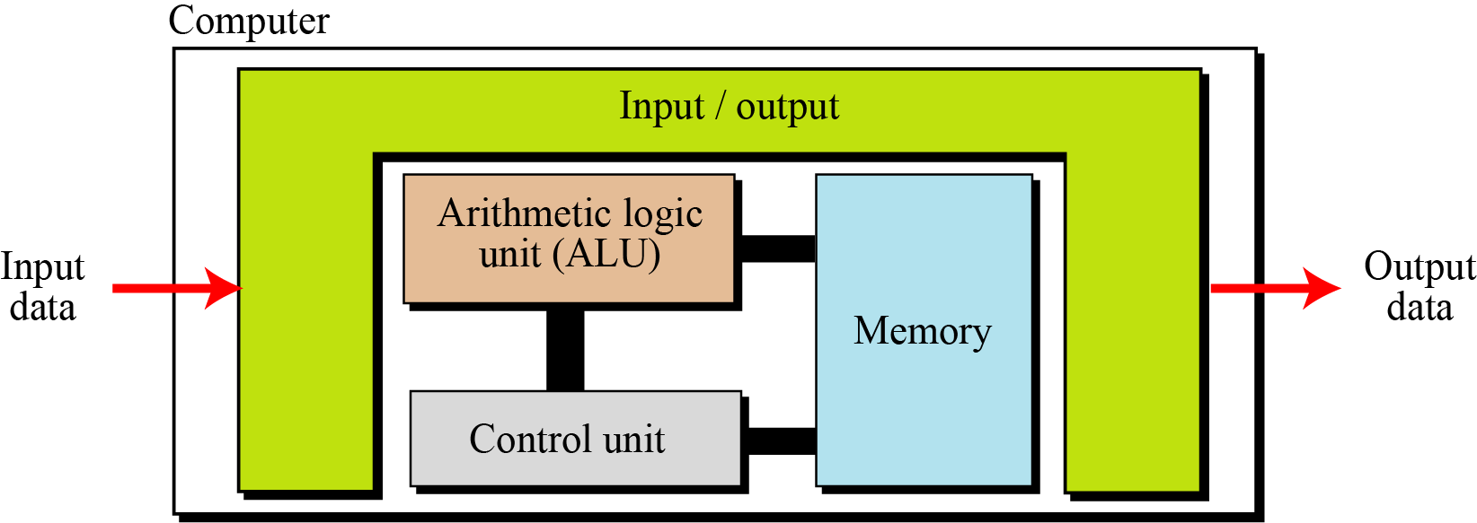
1.2.1 Four subsystems
Computers built on the von Neumann model divide the computer hardware into four subsystems: memory, arithmetic logic unit, control unit, and input/output (Figure 1.5).
Figure 1.5 The von Neumann model
Notes:
1.#
ALU là phần nhỏ, chuyên sâu hơn trong CPU
Memory: RAM, ROM

Slide 11
1.2.2 The stored program concept
The von Neumann model states that the program must be stored in memory. This is totally different from the architecture of early computers in which only the data was stored in memory: the programs for their task was implemented by manipulating a set of switches or by changing the wiring system.
The memory of modern computers hosts both a program and its corresponding data. This implies that both the data and programs should have the same format, because they are stored in memory. In fact, they are stored as binary patterns in memory—a sequence of 0s and 1s.
Notes:
1.#

Slide 12
1.2.3 Sequential execution of instructions
A program in the von Neumann model is made of a finite number of instructions. In this model, the control unit fetches one instruction from memory, decodes it, then executes it. In other words, the instructions are executed one after another. Of course, one instruction may request the control unit to jump to some previous or following instruction, but this does not mean that the instructions are not executed sequentially. Sequential execution of a program was the initial requirement of a computer based on the von Neumann model. Today’s computers execute programs in the order that is the most efficient.
Notes:
1.#

Slide 13
1-3 COMPUTER COMPONENTS
We can think of a computer as being made up of three components: computer hardware, data, and computer software.
Notes:
1.#

Slide 14
1.3.1 Computer hardware
Computer hardware today has four components under the von Neumann model, although we can have different types of memory, different types of input/output subsystems, and so on. We discuss computer hardware in more detail in Chapter 5.
1.3.2 Data
The von Neumann model clearly defines a computer as a data processing machine that accepts the input data, processes it, and outputs the result.
Notes:
1.#

Slide 15
1.3.3 Computer software
The main feature of the Turing or von Neumann models is the concept of the program. Although early computers did not store the program in the computer’s memory, they did use the concept of programs. Programming those early computers meant changing the wiring systems or turning a set of switches on or off. Programming was therefore a task done by an operator or engineer before the actual data processing began.
Notes:
1.#

Slide 16
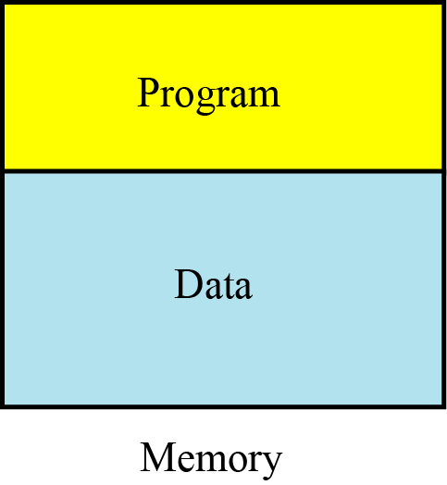
Figure 1.6 Program and data in memory
Notes:
1.#

Slide 17
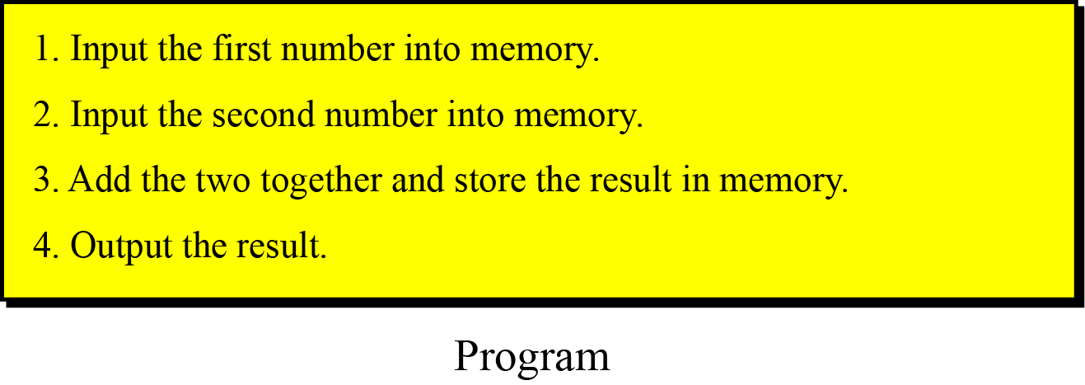
Figure 1.7 A program made of instructions
Notes:
1.#

Slide 18
1-4 HISTORY
In this section we briefly review the history of computing and computers. We divide this history into three periods.
1.4.1 Mechanical machines (before 1930)
1.4.2 The birth of electronic computers (1930–1950)
1.4.3 Computer generations (1950–present)
Notes:
1.#

Slide 19
1.4.1 Mechanical machines (before 1930)
During this period, several computing machines were invented that bear little resemblance to the modern concept of a computer.
In the 17th century, Blaise Pascal, a French mathematician and
philosopher, invented Pascaline.
In the late 17th century, German mathematician Gottfried Leibnitz
invented Leibnitz’ Wheel.
First machine that used the idea of storage and programming was the Jacquard loom, invented by Joseph-Marie Jacquard at the beginning of the 19th century.
Notes:
1.#
Máy cơ

Slide 20
In 1823, Charles Babbage invented the Difference Engine. Later,
he invented a machine called the Analytical Engine that parallels
the idea of modern computers.
In 1890, Herman Hollerith, working at the US Census Bureau,
designed and built a programmer machine that could automatically
read, tally, and sort data stored on punched cards. (đọc, kiểm đếm và sx)
Notes:
1.#

Slide 21
1.4.2 The birth of electronic computers (1930–1950)
Between 1930 and 1950, several computers were invented by scientists who could be considered the pioneers of the electronic computer industry.
Early electronic computers
The early computers of this period did not store the program in memory — all were programmed externally. Five computers were prominent during these years:
ABC
Z1
Mark1
Colossus
ENIAC
Notes:
1.#

Slide 22
Computers based on the von Neumann model
The preceding five computers used memory only for storing data, and were programmed externally using wires or switches. John von Neumann proposed that the program and the data should be stored in memory. That way, every time we use a computer to do a new task, we need only change the program instead of rewiring the machine or turning hundreds of switches on and off.
The first computer based on von Neumann’s ideas was made in 1950 at the University of Pennsylvania and was called EDVAC. At the same time, a similar computer called EDSAC was built by Maurice Wilkes at Cambridge University in England.
Notes:
1.#
EDVAC (Electronic Discrete Variable Automatic Computer) was one of the earliest electronic computers.
Unlike its predecessor the ENIAC, it was binary rather than decimal, and was designed to be a stored-program computer.
The Electronic delay storage automatic calculator (EDSAC) was an early British computer.
Inspired by John von Neumann's seminal First Draft of a Report on the EDVAC,
the machine was constructed by Maurice Wilkes and his team at the
University of Cambridge Mathematical Laboratory in England.

Slide 23
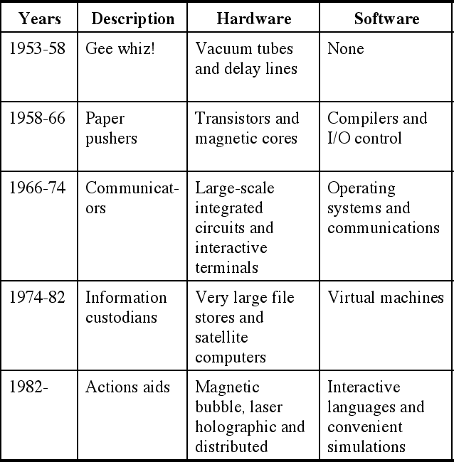
1.4.3 Computer generations (1950–present)
Computers built after 1950 more or less follow the von Neumann model. They have become faster, smaller, and cheaper, but the principle is almost the same. Historians divide this period into generations, with each generation witnessing some major change in hardware or software (but not in the model).
First generation
The first generation (roughly 1950–1959) is characterized by the emergence of commercial computers. (UNIVAC)
Notes:
1.#
Basic technology: Vacuum tubes
Typical computers:
ENIAC (Electronic Numerical Integrator And Computer)
EDVAC (Electronic Discrete Variable Computer) and John Von Neumann
IAS computer (Princeton Institute for Advanced Studies)
Commercial Computers: UNIVAC ((Universal Automatic Computer)
IBM Computers ( International Business Machines)

Slide 24
Second generation
Second-generation computers (roughly 1959–1965) used transistors instead of vacuum tubes. Two high-level programming languages, FORTRAN and COBOL invented and made programming easier.
Third generation
The invention of the integrated circuit reduced the cost and size of computers even further. Minicomputers appeared on the market. Canned programs, popularly known as software packages, became available. This generation lasted roughly from 1965 to 1975.
Notes:
1.#

Slide 25
Fourth generation
The fourth generation (approximately 1975–1985) saw the appearance of microcomputers. The first desktop calculator, the Altair 8800, became available in 1975. This generation also saw the emergence of computer networks.
Fifth generation
This open-ended generation started in 1985. It has witnessed the appearance of laptop and palmtop computers, improvements in secondary storage media (CDROM, DVD and so on), the use of multimedia, and the phenomenon of virtual reality.
Notes:
1.#

Slide 26
1-5 COMPUTER SCIENCE AS A DISCIPLINE
With the invention of computers, a new discipline has evolved: computer science. Like any other discipline, computer science has now divided into several areas. We can divide these areas into two broad categories: systems areas and applications areas. This book is a breadth-first approach to all these area. After reading the book, the reader should have enough information to select the desired area of specialty.
Notes:
1.#

Slide 27
1-6 OUTLINE OF THE COURSE
After this introductory chapter, the book is divided into five parts.
1.6.1 Part I: Data representation and operation
This part includes Chapters 2, 3, and 4. Chapter 2 discuss number systems, how a quantity can be represented using symbols. Chapter 3 discusses how different data is stored inside the computer. Chapter 4 discusses some primitive operations on bits.
Notes:
1.#

Slide 28
1.6.2 Part II: Computer hardware
This part includes Chapters 5 and 6. Chapter 5 gives a general idea of computer hardware, discussing different computer organizations. Chapter 6 shows how individual computers are connected to make computer networks, and internetworks (internets).
1.6.3 Part III: Computer software
This part includes Chapters 7, 8, 9, and 10. Chapter 7 discusses operating systems. Chapter 8 shows how problem solving is reduced to writing an algorithm for the problem. Chapter 9 takes a journey through the list of contemporary
programming languages. Finally, Chapter 10 is a review of software engineering.
Notes:
1.#

Slide 29
1.6.4 Part IV: Data organization and abstraction
Part IV includes Chapters 11, 12, 13, and 14. Chapter 11 discuss data structure, collecting data of the same or different type under one category. Chapter 12 discusses abstract data types. Chapter 13 shows how different file structures can be used for different purposes. Finally, Chapter 14 discusses databases.
1.6.5 Part V: Advanced topics
This part covers Chapters 15, 16, 17, and 18. Chapter 15 discusses data compression. Chapter 16 explores some issues to do with security. Chapter 17 discusses the theory of computation. Finally Chapter 18 gives some idea of artificial intelligence, a topic with day-to-day challenges in computer science.
Notes:
1.#

Slide 30
1.6.6 Part VI: Social media and social Issues
Part VI briefly discusses social media and social issues, two topics that students of computer science may be interested to explore.
Notes:
1.#

